Slide 1
LECTURE THREE
A CONTINUATION THREAT MODELIING APPROACHES
THREAT MITIGATION

Slide 2
Threat Analysis Using Attack trees
Clearly, what we need is a way to model threats against computer systems. If we can understand all the diﬀerent ways in which a system can be a/acked, we can likely design countermeasures to thwart those a/acks. And if we can understand who the a/ackers are -­‐-­‐ not to mention their abilities, motivations, and goals -­‐-­‐ maybe we can install the proper countermeasures to deal with the real threats
Bruce Schneier, “Modeling Security Threats” http://www.schneier.com/paper-­‐attacktrees-­‐ddj-­‐].html
Purpose
  To gain an understanding of the threats and their severity
  To appreciate from where attacks are likely to occur
  To make decisions about defensive actions

Slide 3
Using a Threat Tree or Attack tree
Create the threat tree and determine which attack is most likely:
  Depends on attacker
    Skill levels, insider knowledge – proﬁling of possible attackers is needed
    Depends on circumstances
Defend against most likely attacks, don’t spend money / time to defend against unlikely attacks
Calculate whether it is worth at all to invest in defences!

Slide 4
Threat Trees / Attack Trees
Provide a means to model security threats
  Is a way to classify and organise threats
  Many variations exist
Reading:
Bruce Schneier, “Modeling Security Threats” http://www.schneier.com/paper-­‐attacktrees-­‐ddj-­‐
].html

Slide 5
2. Threat or Attack trees
Threat modeling using attack trees is another methodology used to model threats to software systems.
Attack trees/threat trees are conceptual diagrams showing how an asset, or target, might be attacked. Attack trees have been used in a variety of applications. In the field of information technology, they have been used to describe threats on computer system and possible attacks to realize those threats.
However, their use is not restricted to the analysis of conventional information systems. They are widely used in the fields of defense and aerospace for the analysis of threats against tamper resistant electronics systems (e.g., avionics on military aircraft). Attack trees are increasingly being applied to computer control systems (especially relating to the electric power grid. Attack trees have also been used to understand threats to physical systems.

Slide 6
Threat Modeling Process – Identify the Threats by Using Attack Trees
What are the conditions that allow the threat to take place (THREAT TREES)
Building threat trees is an effective method for determining computer system security issues. The idea behind threat trees is that an application is composed of threat targets and that each target could have vulnerabilities that when successfully attacked could compromise the system.
The threat tree describes the decision-making process an attacker would go through to compromise the software component.
The decomposition process has helped you to identify all the system components. You then identify potential threats to each component. Threat trees then help you decide how that threat could manifest itself.

Slide 7
Threat Modeling Process – Identify the Threats by Using Attack Trees cont’d
An attack tree and a threat tree are the same thing. In a traditional application threat model, you start with the component that you're building, (be that the entire application, a component or function, a data flow, etc.) and enumerate the potential threats to that component.
When you're building an attack tree, the development is reversed. You start with the attacker's end goal, and then enumerate the possible ways you could achieve the end goal, and only then look at the application to find locations where it may be vulnerable to the vectors you've identified.
Ideologically, attack trees are more a red-team style attacker-centric approach to the problem, which can provide useful additional insight.

Slide 8
Threat Trees
Provide a methodical way of describing the security of systems, based on threats
Threats are ordered into a tree-­‐like structure
  The root node of this tree represents the overall goal of an attacker
  Intermediary nodes represent sub-­‐goals for the attacker to achieve in order to achieve the overall goal
  The leaf nodes represent the diﬀerent ways or possible attacks how to achieve this goal

Slide 9
Threat Trees
Threat trees have two kinds of nodes:
  OR nodes: represent alternative attacks
  AND nodes: represent the need that all steps (attacks) have to be taken for achieving a higher-­‐ level goal
In the safe example:
  AND node “eavesdrop”: attackers have to listen in to conversations and get safe owner to actually say the combination

Slide 10
Threat or Attack trees cont’d
A tree structure is used to represent attacks against a system where goal is at the root node and different ways of achieving that goal are the leaf nodes.
Each node becomes a sub goal, and children of that node are the ways to achieve that sub goal.
OR nodes are used to represent alternatives and AND nodes are used to represent different steps toward achieving the same goal.

Slide 11
Threat or Attack trees cont’d
After the tree is built different values can be assigned to the leaf nodes and these values are used to calculate the security of the goal.
These values are totally dependent on the security expert and system engineer. The assignment of values is a manual process.
The other attributes such as time required completing a step, operational expense, expertise required to launch an attack etc. can also be added to attack trees.

Slide 12
Threat Trees: Using them for Defence
By creating such a Threat Tree, a company can analyse possible threats (courses of actions an attacker could take) and create defences against them
Add annotations:
  Leaf nodes in the Threat Tree are annotated with additional information
  This information is propagated up the tree and aggregated according to AND and OR nodes
  In our example
    Nodes representing possible attacks are regarded by a company as either “possible” or “impossible”
    Company has to take measures that, in particular, counteract possible kinds of attacks
    They may ignore “impossible” attacks (saves money)
  Other possible annotations: Assumed costs, etc

Slide 13
Threat Trees: Annotations
Add annotations to each node:
  Determine, whether a particular attack is “possible” or “impossible”
  What it means for OR nodes
    the attack represented by an OR node is possible if any of its child nodes are possible
    The attack represented by an OR node is impossible if all
child nodes are annotated as being impossible
  What it means for AND nodes
    The attack represented by an AND node is possible only if all
child nodes are annotated as being possible
    The attack represented by an AND node is impossible if any
of its child nodes are impossible

Slide 14
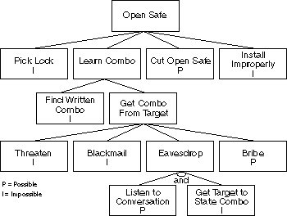
Threat Tree: Opening a Physical Safe
Goal
How

Slide 15
Threat Tree: AND and OR nodes
c
AND

Slide 16
Threat Trees cont’d
We can also describe Threat Trees more conveniently in outline form (in particular, if they become very large):
Goal: Open Save
  Pick Lock
  Learn Combo (OR)
    Find Written Combination
    Get Combination from Target Person (OR)
      Threaten
      Blackmail
      Eavesdrop (AND)
        Listen to Conversation
        Get Target Person to state Combination
      Bribe
  Cut Open Safe
  Install Safe improperly

Slide 17
Threat Trees: Annotations
Goal
Impossible
Possible
I
c

Slide 18
Threat Trees: Using them for Defence
Interpreting an annotated Threat Tree
  Annotations in our example
    “possible” / “impossible”
  Analysis of example results in insight that
    Attackers may cut open safe, or
    Learn the combination by bribing
  Company has to take measures that, in particular, counteract these kinds of attacks
  They may ignore “impossible” attacks (saves money)
Additional annotations (e.g. Assumed costs for attacks) may give further insights how to create defences and how much to invest against what type of attack

Slide 19
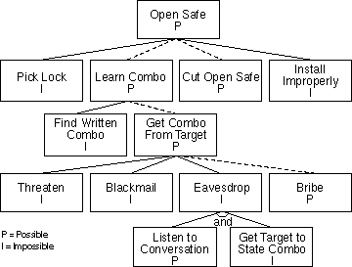
Threat Trees: Annotations
Goal
Impossible
Possible
Dotted lines show possible attacks

Slide 20
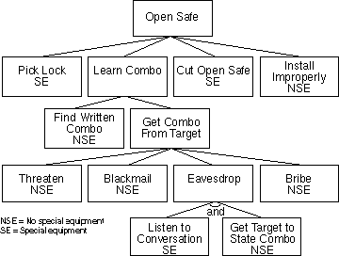
Threat Tree: Other possible Annotations
Threat trees can have other annotations as well, such as
  “easy” versus “hard”
  “expensive” versus “inexpensive”
  “intrusive” versus “nonintrusive”
  “legal” versus “illegal
  “special equipment” versus “no special equipment

Slide 21
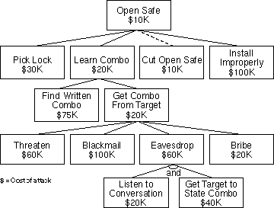
Threat Trees: Assigning Costs
A company can also analyse the possible costs of attacks:
  OR nodes will be annotated by the cost of their cheapest child node
  AND nodes will be annotated with the sum of the costs of all child nodes
Find cheapest attack and defend against it in particular

Slide 22
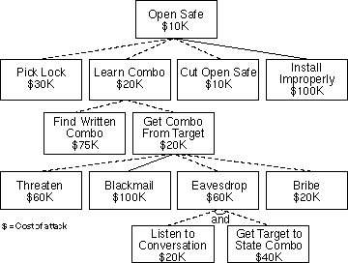
Threat Trees: Assign Costs
E.g.: ﬁnd all attacks that cost less than
$100K
– Dotted lines point out all these attacks/ threats
Invest in defences against these threats

Slide 23
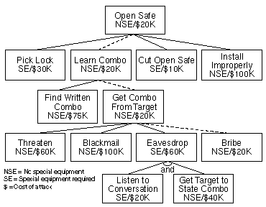
Threat Trees: Combine Annotations
E.g: “Find cheapest attack that requires no special equipment”

Slide 24
Creating a Threat Tree
Procedure:
  Identify possible attack goals
    Each of these goals is the starting point for a separate Threat Tree or a sub-­‐tree of a single Threat Tree
  Identify possible attacks and sub-­‐goals to achieve a top-­‐ level goal, add concrete attacks as leaf nodes, add sub-­‐ goals to the tree
  Repeat 2. for each added sub-­‐goal, until only leaf nodes (concrete attacks) are added to the tree
  Assign annotations to each leaf node, propagate and aggregate annotations up the tree
  Keep tree updated, if values are changed (company analyst changes values to ask “what-­‐if” questions)

Slide 25
Threat Modeling Process – Identify the Threats by Using Attack Trees
The way to write a threat tree is to identify goals and sub-goals of an attack, as well as what must be done so that the attack succeeds.
The threat tree on the next slide shows the ways in which an attacker could view another user’s confidential payroll data(this attacker’s end goal).
Although threat trees communicate data well, they can become cumbersome when building large threat models. An alternative way of representing the threat tree is using an outline, as illustrated on the slide.

Slide 26
Attack trees
A branching, hierarchical data structure that represents a set of potential vulnerabilities
Objective: to effectively exploit the info available on attack patterns
  published on CERT or similar forums
  Security analysts can use the tree to guide design and strengthen countermeasures

Slide 27
Threat Modeling Process – Identify the Threats by Using Attack Trees
1.0 View payroll data (I)
1.1 Traffic is unprotected (AND)
1.2 Attacker views traffic
1.2.1 Sniff traffic with protocol analyzer
1.2.2 Listen to router traffic
1.2.2.1 Router is unpatched (AND)
1.2.2.2 Compromise router
1.2.2.3 Guess router password
Threat #1 (I)
View payroll data
1.1
Traffic is
unprotected
1.2
Attacker views
traffic
1.2.1
Sniff traffic with
protocol analyzer
1.2.2
Listen to router
traffic
1.2.2.1
Router is
unpatched
1.2.2.2
Compromise
router
1.2.2.3
Guess router
password

Slide 28
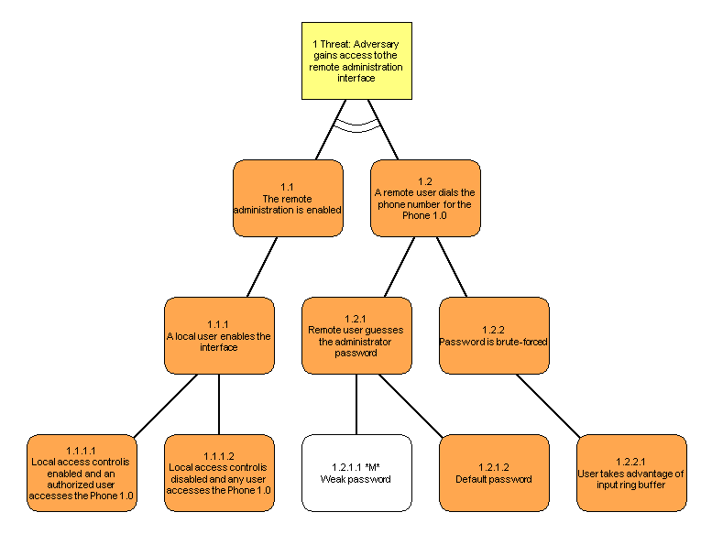
Attack Tree example Remote access to admin

Slide 29
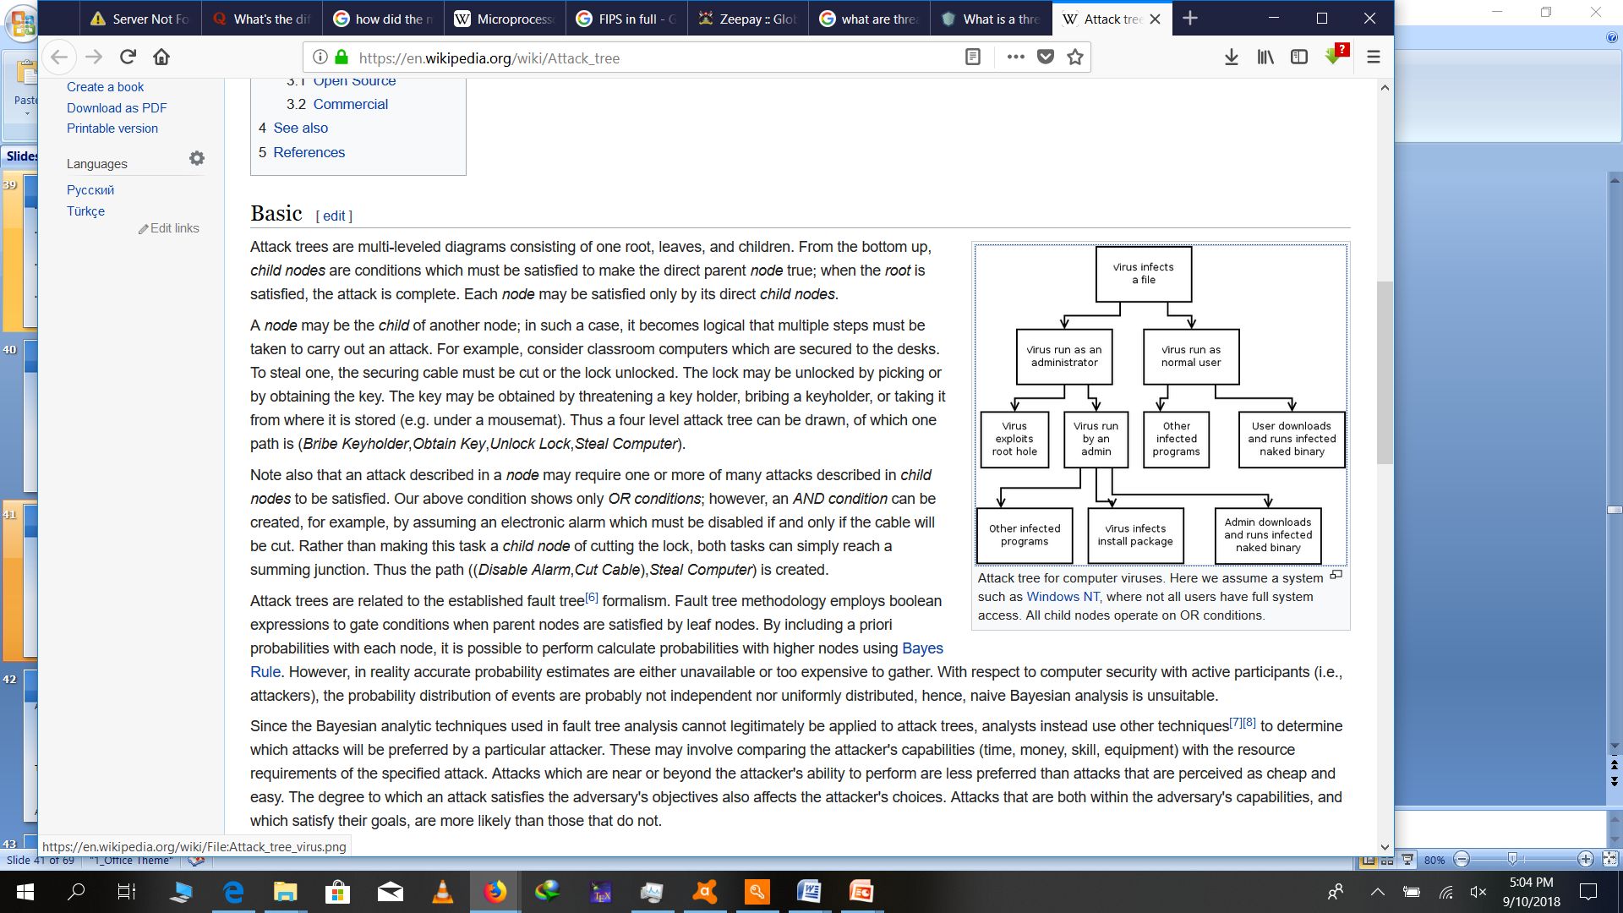
Attack Tree example Virus infecting a file

Slide 30
Attack surfaces
Attack surface: the reachable and exploitable vulnerabilities in a system
  Open ports
  Services outside a firewall
  An employee with access to sensitive info
  …
Three categories
  Network attack surface (i.e., network vulnerability)
  Software attack surface (i.e., software vulnerabilities)
  Human attack surface (e.g., social engineering)
Attack analysis: assessing the scale and severity of threats

Slide 31
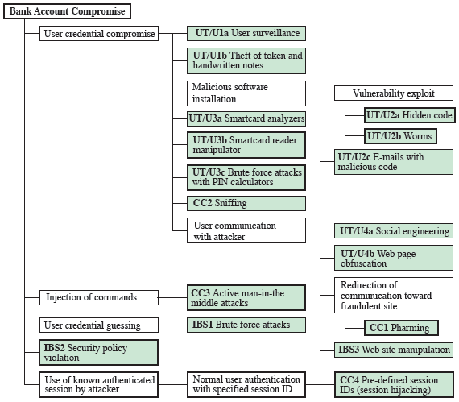
An attack tree example to compromise a bank account

Slide 32
Threat Modeling Process – Step 5: Document the Threats
Document threats by using a template:
Leave Risk blank (for now)
Threat Description | Injection of SQL Commands
Threat target | Data Access Component
Risk
Attack techniques | Attacker appends SQL commands to user name, which is used to form a SQL query
Countermeasures | Use a regular expression to validate the user name, and use a stored procedure with parameters to access the database

Slide 33
Document Threats
Document all the threats you identify.
You must include the threat target and threat description. The Risk is left blank for now, and is completed in the final stage of the process.
You may want to include the attack techniques, which can also highlight the vulnerabilities exploited, and the countermeasures that are required to address the threat.

Slide 34
Threat Modeling Process – Step 6: Rate/measure the Threats
Use formula:
  Risk = Probability * Damage Potential
Use DREAD to rate threats
  Damage potential
  Reproducibility
  Exploitability
  Affected users
  Discoverability

Slide 35
Rate the Threats cont’d
At this step, you can fill in the risk data that you left blank in step 5.
After you document your threats, you need a way to determine which threats are the most dangerous. To do this, you need a way to rank them.
You can calculate risk using a 1-10 scale for probability (where 1 is not probable, 10 is very probable), and 1-10 for damage potential (1 – minimal damage, 10 – catastrophe). This results in a risk in the range of 1 – 100. You can divide the scale into three bands to generate a High, Medium and Low risk rating.

Slide 36
Rate the Threats cont’d
This way of assessing risk is too simplistic for some, so at Microsoft, the DREAD model is used to refine this calculation to add a dimension that assesses what the impact of a security threat really means.
  Damage potential: How much damage can the threat inflict on the system?
  Reproducibility: How difficult is it to reproduce the threat?
  Exploitability: How easy is it for hackers to succeed in exploiting a vulnerability?
  Affected users: How many users will be affected?
  Discoverability: How difficult is it to discover the threat?

Slide 37
Rate the Threats cont’d
Applications and companies use different criteria for different elements of the DREAD model. The formula used to calculate the rank is not as important because the values derived are relative to one another. You just need to be consistent.
DREAD provides a further refinement of the simple
Risk = Damage * Chance formula.
  D (Damage Potential) and A (Affected users) are analogous to Damage.
  R (Reproducibility), E (Exploitability) and D (Discoverability) are analogous to Chance.
  You can use this strategy to prioritize risks. After you calculate the priority for each identified security risk, you can prioritize the risks and determine a management strategy based on the priority value.

Slide 38
Rate the Threats cont’d
  Within each DREAD category, use a score of 3 for high risk, 2 for medium risk, and 1 for low risk.
Assess each threat in your threat tree and assign the risk rating for each of the DREAD categories and add up the result.
For example, the SQL Injection threat identified earlier could have a score of D – 3, R – 3, E – 3 , A – 3, D – 2. This gives a total score of 14.
Across the total possible range of 5 – 15, 12 – 15 may be considered high risk, 8 – 11 as medium risk, and 5 – 7 as low risk.

Slide 39
Calculation of Risk
(How does DREAD do this?)
Risk = Impact * Probability
Impact = (DREAD)
  Damage
    Note that Damage needs to be assessed in terms of Confidentiality, Integrity and Availability
  Affected Users (how large is the user base affected?
Probability = (DREAD)
  Reproducibility (how difficult to reproduce? Is it scriptable?)
  Exploitability (how difficult to use the vulnerability to effect the attack?)
  Discoverability (how difficult to find?)

Slide 40
Calculation of Risk (Cont’d)
Let’s establish a few assumptions
  In the Risk equation; Damage and Probability are equally important
  The factors, as well as the result should have mathematical value (in order to assist in easily determining priorities)
  Therefore in any formula giving each factor equal weight an imbalance occurs giving Probability a 3:2 representation over Damage
To mitigate:
    e.g. Risk = Impact(D+A) * Probability(R+E+D)
    while ensuring the summary of qualitative scales for Risk and Probability are equal (e.g. D+A=(1-10) & R+E+D=(1-10) which results in a scale of 6-100 when the summation of factors are multiplied

Slide 41
Damage
Damage has 3 categories and each has been given it’s own value ranking
  Confidentiality (Read)
    Vulnerability or exposure of sensitive data or process (e.g. application or business logic)
  Integrity (Write)
    Compromise of application or system data integrity (e.g. log tampering, data modification)
  Availability
    Degradation or denial of service

Slide 42
Damage
 | Confidentiality (Read) | Integrity (Write) | Availability (access)
5 – Critical | Data Elements* -SSN, CreditCard, Passwords | Data Elements -SSN, CreditCard, Bank Account # | Domain Control:
4 – High | Data Elements -Bank Acct #, - (as defined} | Data Elements -(as defined} | Moderate Host Control:
3 – Moderate | Data Elements -(as defined} | Data Elements -(as defined} | Partial Denial:
2 – Minor | Data Elements -(as defined} | Data Elements -(as defined} | Degradation
1 – Trivial | Data Elements -(as defined} | Data Elements -(as defined} | Nuisance:

Slide 43
Affected Users
 | Roles (Confidentiality, Integrity) | Population (Availability)
5 | Admin | All
4 | Power Users | Most
3 | Group | Many
2 | User | Few
1 | Public | None

Slide 44
Reproducibility
Value | Description
1 - Complex | The attack is very difficult to reproduce, even with knowledge of the security hole
2 - Moderate | The attack can be reproduced, but only with a timing window and a particular race situation
3 – Simple | The attack can be reproduced every time and does not require a timing window

Slide 45
Exploitability
Value | Description
1-Expert | The exploit is unpublished, difficult to execute and requires significant insider knowledge and technical expertise or multiple vulnerabilities must be exploited before any impact can be realized.
2-Journeyman | The exploit is unpublished, difficult to execute and requires significant insider knowledge or technical expertise.
3-Adept | The exploit is known (including technical and/or insider information) but is difficult to execute and no exploit code is available.
4-Novice | The exploit is well known and automated script has been provided that script-kiddies can run to exploit the vulnerability.

Slide 46
Discoverability
Value | Description
1-Difficult | The vulnerability is obscure, and it is unlikely that users will work out damage potential
2-Moderate | The vulnerability is in a seldom-used part of the product, and only a few users should come across it. It would take some thinking to see malicious use
3-Easy | Published information explains the attack. The vulnerability is found in commonly used features and is very noticeable

Slide 47
Threat modelling finally
Use DREAD to calculate
  The risk before mitigation
  The risk after mitigation
  The cost of implementing the mitigation AND the cost to maintain the mitigation
  NOW you can make an accurate assessment of the best mitigation for a given vulnerability!!!
Example: Using SSL or IPSec to secure IIS – SQL Server
  SSL: Low cost to turn on, but can easily be turned off (what is the cost to validate the mitigation over time?
  IPSec: High cost to turn on initially, but low maintenance cost + INCREASED SECURITY
  Perfect impact on both machines, but Accelerator cards can easily mitigate this

Slide 48
Threat Modeling Process – Example: Rate the Threats
Damage potential
Affected Users
-or-
Damage
Threat #1 (I)
View payroll data
1.1
Traffic is
unprotected
1.2
Attacker views
traffic
Reproducibility
Exploitability
Discoverability
-or-
Chance
1.2.1
Sniff traffic with
protocol analyzer
1.2.2
Listen to router
traffic
1.2.2.1
Router is
unpatched
1.2.2.2
Compromise
router
1.2.2.3
Guess router
password

Slide 49
In summary, threat modeling is a valuable analysis tool which improves the design process. It allows you to identify the most vulnerable parts of your application so you can focus your efforts on those places. It also helps you to identify appropriate techniques for mitigating threats.
The benefit of threat modeling does not end there. Use threat modeling through the coding process to revisit and retest security decisions made in the design phase and to direct focus in security code reviews.
The results of the threat modeling process provide the information necessary to select appropriate security technologies and techniques to mitigate the threats that have been identified.
Data flow diagrams are an effective tool for identifying data flows and are particularly useful for identifying all inputs to your application. Any inputs are a particular source of security vulnerabilities.

Slide 50
Coding to a Threat Model
Use threat modeling to help
  Determine the most “dangerous” portions of your application
  Prioritize security push efforts
  Prioritize ongoing code reviews
  Determine the threat mitigation techniques to employ
  Determine data flow

Slide 51
Risk Mitigation
Secure Development Process
Threat Modeling
Risk Mitigation
Security Best Practices

Slide 52
RISK MITIGATION
As mentioned, the assets of a computer system can be categorized as hardware, software, data, and communication lines and networks. We briefly describe these four categories and relate these to the concepts of integrity, confidentiality, and availability, as illustrated here in Figure 1.3.
Hardware - A major threat = is the threat to availability. Hardware is the most vulnerable to attack and the least susceptible to automated controls. Threats include accidental and deliberate damage to equipment as well as theft. Theft of CDROMs and DVDs can lead to loss of confidentiality. Physical and administrative security measures are needed to deal with these threats.

Slide 53
Software - includes the operating system, utilities, and application programs. A key threat is an attack on availability. Software is often easy to delete. Software can also be altered or damaged to render it useless. Careful software configuration management can maintain high availability. A more difficult problem is software modification (e.g. from virus/worm) that results in a program that still functions but that behaves differently than before, which is a threat to integrity/authenticity.

Slide 54
Data - involves files and other forms of data controlled by individuals, groups, and business organizations. Security concerns with respect to data are broad, encompassing availability, secrecy, and integrity.
In the case of availability, the concern is with the destruction of data files, which can occur either accidentally or maliciously.
The obvious concern with secrecy is the unauthorized reading of data files or databases. A less obvious secrecy threat involves the analysis of data and manifests itself in the use of so-called statistical databases, which provide summary or aggregate information.
Finally, data integrity is a major concern in most installations. Modifications to data files can have consequences ranging from minor to disastrous.

Slide 55
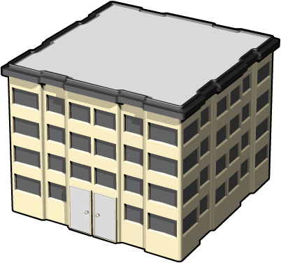




Risk Mitigation Options
Do Nothing
Option 1
Warn the User
Option 2
Remove the Problem
Option 3
Fix It
Option 4
Patrolled

Slide 56
Risk Mitigation Process
Threat Type
(STRIDE)
1
Identify category
For example: Spoofing
Select techniques
For example: Authentication or Protect secret data
Mitigation Technique
Mitigation Technique
2
3
Choose technology
For example: Kerberos
Technology
Technology
Technology
Technology
NTLM
X.509 certs
PGP keys
Basic
Digest
Kerberos
SSL/TLS
Spoofing
Authentication
1
2
3

Slide 57



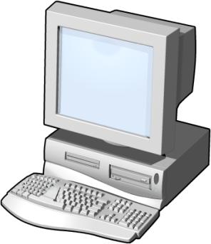
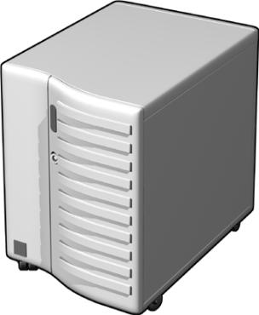


Sample Mitigation Techniques
SSL/TLS
IPSec
RPC/DCO with Privacy
STRIDE
STRIDE
Configuration
Data
STRIDE
Strong access control
Digital signatures
Auditing
Insecure
Network
Firewall
Limiting resource utilization for anonymous connections
Authentication
Data
Client
STRIDE
Server
Persistent
Data
STRIDE

Slide 58
Further mitigation Requirements in order of Priority
Database Security
Mange privileged users
Patch management
Unstructured data management
Endpoint security(firewalls, antiviruses should be widened to cover applications and privileges)
Employee security awareness
Manage vendor and third party security
Senior management level security
Security and cyber security Architecture
Maintain vigilance

Slide 59
Security Best Practices
Secure Development Process
Threat Modeling
Risk Mitigation
Security Best Practices

Slide 60
1.Run with Least Privilege
Well-known security doctrine:
  “Run with just enough privilege to get the job done, and no more!”
Elevated privilege can lead to disastrous consequences
  Malicious code executing in a highly privileged process runs with extra privileges too
  Many viruses spread because the recipient has administrator privileges

Slide 61
Demonstration 1: ASP.NET Applications Security
Investigating a program’s Application Privileges
Restricting a program’s Applications Trust Levels
Sandboxing Privileged Code
Using Sandboxed Assemblies

Slide 62
2. Reduce the Attack Surface
Expose only limited, well documented interfaces from your application
Use only the services that your application requires
  The Slammer and CodeRed viruses would not have happened if certain features were not on by default
  ILoveYou (and other viruses) would not have happened if scripting was disabled
Turn everything else off

Slide 63
3. Do Not Trust User Input
Validate all input
  Assume all input is harmful until proven otherwise
  Look for valid data and reject everything else
Constrain, reject, and sanitize user input with
  Type checks
  Length checks
  Range checks
  Format checks
Validator.ValidationExpression =
"\w+([-+.]\w+)*@\w+([-.]\w+)*\.\w+([-.]\w+)*";

Slide 64
Demonstration 2: Windows Forms for Validation
Viewing a Non-Validating Application
Adding Input Validation
Validating the Complete Form

Slide 65
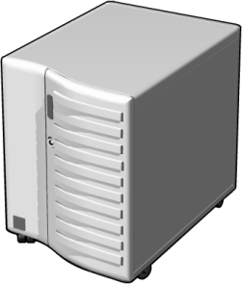
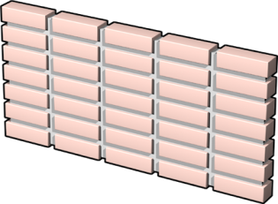

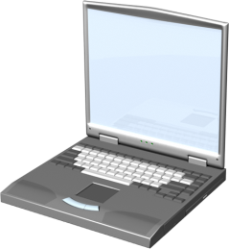
4. Defense in Depth (1 of 3) – Use Multiple Gatekeepers
IIS
ISA Firewall
ISA Firewall
SQL Server
SSL
IPSec

Slide 66


Defense in Depth (2 of 3) – Apply Appropriate Measures for Each Layer
Check security
Check security
Application.dll
Application.exe
Secure resource with an ACL
Check security
Application.dll
Check security

Slide 67
Defense in Depth (3 of 3) – Use Strong ACLs on Resources
Design ACLs into the application from the beginning
Apply ACLs to files, folders, Web pages, registry settings, database files, printers, and objects in Active Directory
Create your own ACLs during application installation
Include DENY ACEs
Do not use NULL DACLs

Slide 68
5.Do Not Rely on Security by anonymity
Do not hide security keys in files
Do not rely on undocumented registry keys
Always assume an attacker knows everything you know

Slide 69
6.Use Data Protection API (DPAPI) to Protect Secrets
Two DPAPI functions:
  CryptProtectData
  CryptUnprotectData
Two stores for data encrypted with DPAPI:
  User store
  Machine store

Slide 70
7.Fail Intelligently (1 of 2)
DWORD dwRet = IsAccessAllowed(…);
if (dwRet == ERROR_ACCESS_DENIED) {
// Security check failed.
// Inform user that access is denied
} else {
// Security check OK.
// Perform task…
}
What if
IsAccessAllowed()
returns
ERROR_NOT_
ENOUGH_MEMORY?
If your code does fail, make sure it fails securely

Slide 71
Fail Intelligently (2 of 2)
Do not:
  Reveal information in error messages
  Consume resources for lengthy periods of time after a failure
Do:
  Use exception handling blocks to avoid propagating errors back to the caller
  Write suspicious failures to an event log
  Use ascertions
<customErrors mode="On"/>

Slide 72
8. Test Security
Involve test teams in projects at the beginning
Use threat modeling to develop security testing strategy
Think Evil. Be Evil. Test Evil.
  Automate attacks with scripts and low-level programming languages
  Submit a variety of invalid data
  Delete or deny access to files or registry entries
  Test with an account that is not an administrator account
Know your enemy and know yourself
  What techniques and technologies will hackers use?
  What techniques and technologies can testers use?

Slide 73
9.Learn from Mistakes
If you find a security problem, learn from the mistake
  How did the security error occur?
  Has the same error been made elsewhere in the code?
  How could it have been prevented?
  What should be changed to avoid a repetition of this kind of error?
  Do you need to update educational material or analysis tools?

